Slide 1

PROJECT WORK IN MACHINE LEARNING CREDIT CARD FRAUD DETECTION
Professor
Claudio Sartori
Presented By
Yellam Naidu Kottavalasa
Matricola: 0000985387

Slide 2
ABSTRACT
It is vital that credit card companies can identify fraudulent credit card transactions so that customers are not charged for items that they did not purchase. Such problems can be tackled with Data Science and its importance, along with Machine Learning, cannot be overstated. This project intends to illustrate the modeling of a data set using machine learning with Credit Card Fraud Detection. Credit Card Fraud Detection is a typical sample of classification. In this process, we have focused on analyzing and pre-processing data sets as well as Machine Learning (ML)techniques are very useful in predicting outcomes for a large amount of data. In this project three machine learning algorithms such as Logistic Regression(LR), Decision Tree (DT), and Random Forest (RF) Classifiers are applied to predict credit card fraud transactions.

Slide 3
Contents
Introduction
Project Pipeline
Data Collection
Analyzing Data
Preprocessing
Model Creation
Evaluation of Models
Conclusion

Slide 4
Introduction
'Fraud' in credit card transactions is unauthorized and unwanted usage of an account by someone other than the owner of that account. Necessary prevention measures can be taken to stop this abuse and the behavior of such fraudulent practices can be studied to minimize it and protect against similar occurrences in the future. In other words, Credit Card Fraud can be defined as a case where a person uses someone else’s credit card for personal reasons while the owner and the card-issuing authorities are unaware of the fact that the card is being used.
Fraud detection involves monitoring the activities of populations of users in order to estimate, perceive or avoid objectionable behavior, which consists of fraud, intrusion, and defaulting.

Slide 5
Project Pipeline
Data Collection
Analyzing Data
Univariate Analysis
Bivariate Analysis
Data Preprocessing
Model Creation
Logistic Regression
Decision Tree
Random Forest
Evaluation Of Models
Accuracy
Precision
Recall
Confusion Matrix

Slide 6
Data Collection
Data collection is the systematic approach to gathering and measuring information from a variety of sources to get a complete and accurate picture of an area of interest.
In this project the Dataset is taken from the Kaggle Website containing 12,96,675 transactions of both legitimate and fraud transactions from the duration of 1st January 2019 to 30th June 2020. It covers credit cards of 1000 customers doing transactions with a pool of 800 merchants.
Test
Train

Slide 7
Analyzing Data
Data analysis is a process of inspecting, transforming, and modeling data with the goal of discovering useful information, informing conclusions, and supporting decision-making.
Here the data can be visualized in two ways. They are
Analyzing Data
Univariate Analysis
Bivariate Analysis
Univariate Analysis
Bivariate Analysis

Slide 8
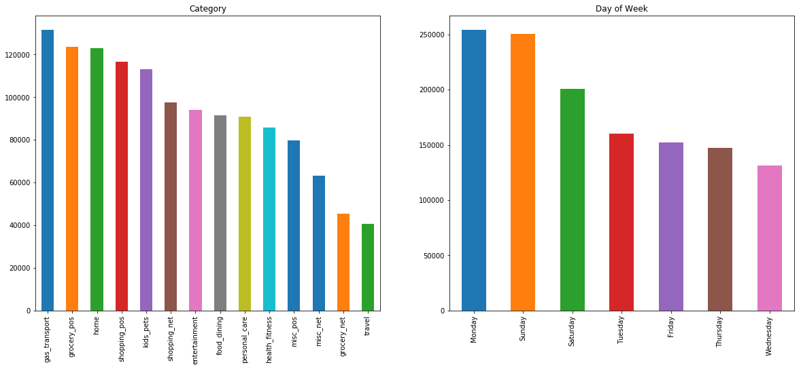
Project analysis slide 3
Univariate Analysis
Univariate data visualization plots help us to enumerative properties as well as a descriptive summary of the particular data variable. These plots help in understanding the location/position of observations in the data variable, its distribution.
gas_transport of the category has the highest credit card transactions.
Sunday and Monday of the week have the highest credit card transactions.
Notes:
8

Slide 9
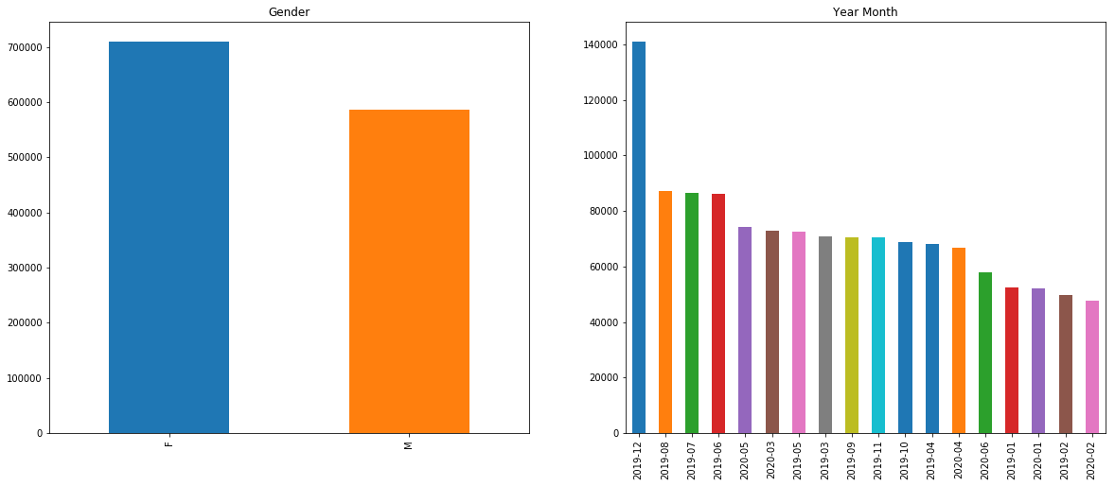
Females are done the more Credit card transactions compared to Male.
Highest number of transactions are in the month of December.
Lowest number of transactions happens in February month.

Slide 10
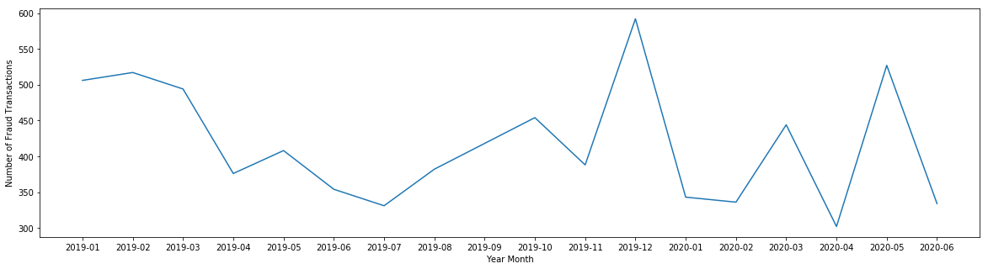
Project analysis slide 4
Bivariate Analysis
Bivariate analysis is finding some kind of empirical relationship between two variables. Specifically, the dependent vs independent Variables.
More fraud transactions are in the December month of 2019 and the lowest fraud transactions in April month of 2020.
Notes:
10

Slide 11
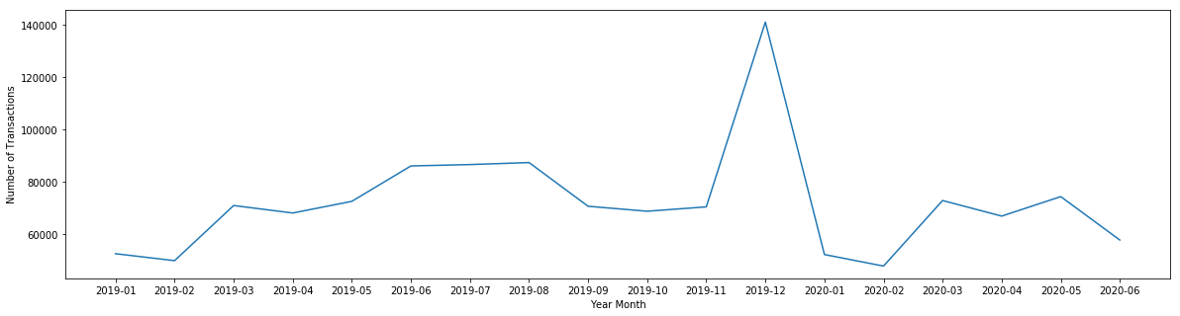
Plotting between the year month and number of transactions.
More number of transactions are in the December month of 2019 and the lowest transactions in February month of 2020.

Slide 12
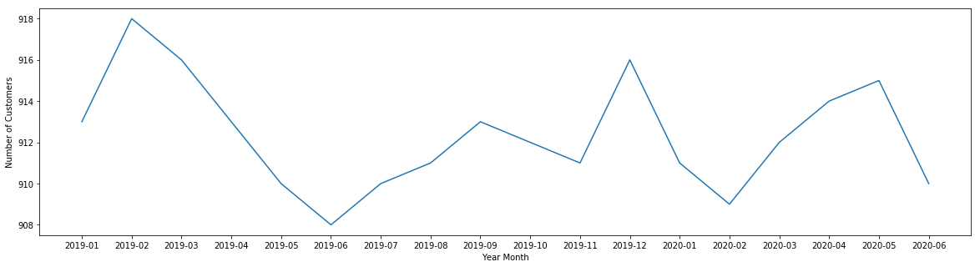
Plotting between the year month and number of Customers.
More number of customers are in the February month of 2019 and the lowest number of customers in June month of 2019.

Slide 13



Data Preprocessing
Data normalization is applied to some features in the dataset is used in machine learning to make model training less sensitive to the scale of features.
In this case, a one-hot encoding can be applied to the integer representation. This is where the integer encoded variable is removed and a new binary variable is added for each unique integer value.
The Dataset is highly imbalanced we must balance this by oversampling. Oversampling involves randomly selecting examples from the minority class, with replacement, and adding them to the training dataset.

Slide 14
Project analysis slide 8
Model Creation
In this step, we can try different models and fine-tune their hyperparameters until we get the desired level of performance on the given dataset.
Logistic Regression
Logistic regression is a supervised learning classification algorithm used to predict the probability of a target variable. The nature of the target or dependent variable is dichotomous, which means there would be only two possible classes.
Logistic regression is predictive analysis, it is used to describe the data and to explain the relationship between one dependent binary variable and one independent binary variable
Notes:
14

Slide 15
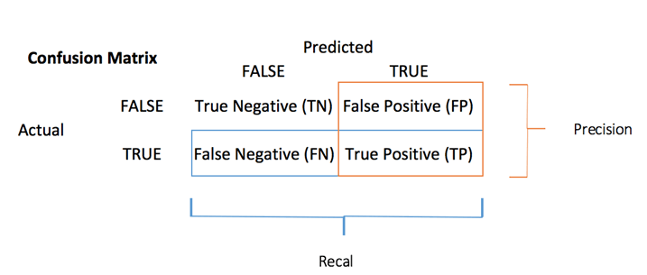
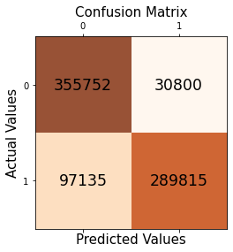
Evaluation of Logistic Regression Model
Confusion Matrix: A Confusion matrix is an N x N matrix used for evaluating the performance of a classification model, where N is the number of target classes. The matrix compares the actual target values with those predicted by the machine learning model.
Model Accuracy: Model Accuracy is a machine learning model performance metric that is defined as the ratio of true positives and true negatives to all positive and negative observations.
Mathematically, it represents the ratio of the sum of true positive and true negatives out of all the predictions.
Accuracy Score = (TP + TN)/ (TP + FN + TN + FP)
The accuracy Score of the Logistic Regression Model is 83.46 %

Slide 16
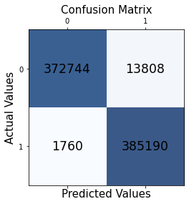
Decision Tree Classification
Decision Tree is a Supervised learning technique that can be used for both classification and Regression problems, but mostly it is preferred for solving Classification problems. It is a tree-structured classifier, where internal nodes represent the features of a dataset, branches represent the decision rules, and each leaf node represents the outcome.
We have used the Gini index as our attribute selection method for the training of the decision tree classifier with the Sklearn function DecisionTreeClassifier().
Evaluation of Decision Tree Classification Model
The confusion matrix predicts more True positives ( TP = 385190 ) values. 385190 positive class data points were correctly classified by the model.
The accuracy Score of the Decision Tree Classification Model is 97.98 %

Slide 17
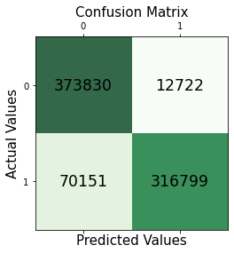
Random Forest Classifier
Random forests is a supervised learning algorithm. It can be used both for classification and regression. It is also the most flexible and easy to use algorithm.
Random forests creates decision trees on randomly selected data samples, gets prediction from each tree and selects the best solution by means of voting. It also provides a pretty good indicator of the feature importance.
Evaluation of Decision Tree Classification Model
The confusion matrix predicts more True positives ( TP = 316799 ) values. 316799 positive class data points were correctly classified by the model.
The accuracy Score of the Decision Tree Classification Model is 89.28 %

Slide 18
Conclusion
Credit card fraud is without a doubt an act of criminal dishonesty. In this project the most common methods of fraud along with their detection methods and reviewed recent findings in this field. Here the machine learning can be applied to get better results in fraud detection.
Decision Tree Classifier gives the highest accuracy i.e. 97.98% when compared to logistic regression and random forest classifier.
The precision is also high of decision tree classifier it measures the count of true positives in a correct manner out of all positive predictions made.
The recall of the Decision tree classifier is more out of the other models, it is the count of true positives in the correct manner out of all the actual positive values.

Slide 19
Thank You

